Slide 1


GIT
With
CHERRY-PICK
Presented By : MAYURI DHOTE

Slide 2

Agenda
GIT Command and Cherry-Pick execution with GIT Bash
Introduction of GIT
Features of GIT
Used of GIT
GIT Workflow
Working of GIT Command
GIT CHERRY-PICK
IMPLEMENTATION

Slide 3
Introduction of GIT
Git is a free and open source distributed version control system designed to handle everything from small to very large projects with speed and efficiency.
Git is easy to learn and has a tiny footprint with lightning fast performance. It outclasses SCM tools like Subversion, CVS, Perforce, and ClearCase with features like cheap local branching, convenient staging areas, and multiple workflows.
Branching
Merging
Small and Fast
Distributed
Data Assurance
Trademark
Staging Area
Free
Open Source

Slide 4
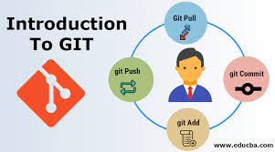

Features of GIT
Tracks history
Free and open source
Supports non-linear development
Creates backups
Scalable
Supports collaboration
Branching is easier
Distributed development

Slide 5


Uses of GIT
Git is the most commonly used version control system. Git tracks the changes you make to files, so you have a record of what has been done, and you can revert to specific versions should you ever need to. Git also makes collaboration easier, allowing changes by multiple people to all be merged into one source.
Git is software that runs locally. Your files and their history are stored on your computer. You can also use online hosts (such as GitHub or Bitbucket) to store a copy of the files and their revision history. Having a centrally located place where you can upload your changes and download changes from others, enable you to collaborate more easily with other developers.
Git can automatically merge the changes, so two people can even work on different parts of the same file and later merge those changes without loosing each other’s work!

Slide 6
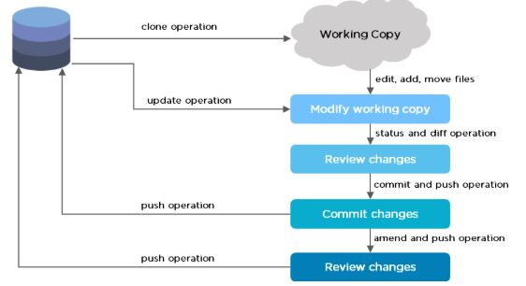
GIT WORKFLOW
The Git workflow is divided into three states:
Working directory - Modify files in your working directory
Staging area (Index) - Stage the files and add snapshots of them to your staging area
Git directory (Repository) - Perform a commit that stores the snapshots permanently to your Git directory. Checkout any existing version, make changes, stage them and commit.

Slide 7
Working with repositories- GIT Commands
git init
This command turns a directory into an empty Git repository. This is the first step in creating a repository. After running git init, adding and committing files/directories is possible
# change directory to codebase
$ cd /file/path/to/code
# make directory a git repository
$ git init
git add
Adds files in the to the staging area for Git. Before a file is available to commit to a repository, the file needs to be added to the Git index (staging area). There are a few different ways to use git add, by adding entire directories, specific files, or all unstaged files.
Usage:
$ git add <file or directory name>

Slide 8
Working with repositories- GIT Commands
git commit
Record the changes made to the files to a local repository. For easy reference, each commit has a unique ID.
# Adding a commit with message
$ git commit -m "Commit message in quotes“
git status
This command returns the current state of the repository.
git status will return the current working branch. If a file is in the staging area, but not committed, it shows with git status. Or, if there are no changes it’ll return nothing to commit, working directory clean.
$ git status
git branch
To determine what branch the local repository is on, add a new branch, or delete a branch.
# Create a new branch - $ git branch <branch_name>
# List all remote or local branches - $ git branch -a
# Delete a branch- $ git branch -d <branch_name>

Slide 9
Working with repositories- GIT Commands
git checkout
To start working in a different branch, use git checkout to switch branches.
# Checkout an existing branch
$ git checkout <branch_name>
# Checkout and create a new branch with that name
$ git checkout -b <new_branch>
git remote
To connect a local repository with a remote repository. A remote repository can have a name set to avoid having to remember the URL of the repository.
# Add remote repository
$ git remote <command> <remote_name> <remote_URL>
# List named remote repositories
$ git remote -v

Slide 10
Working with repositories- GIT Commands
git clone
To create a local working copy of an existing remote repository, use git clone to copy and download the repository to a computer. Cloning is the equivalent of git init when working with a remote repository. Git will create a directory locally with all files and repository history.
$ git clone <remote_URL>
git pull
To get the latest version of a repository run git pull. This pulls the changes from the remote repository to the local computer.
$ git pull <branch_name> <remote_URL/remote_name>
git push
Sends local commits to the remote repository. git push requires two parameters: the remote repository and the branch that the push is for
$ git pu$ git push <remote_URL/remote_name> <branch>
# Push all local branches to remote repository
$ git push —allll <branch_name> <remote_URL/remote_name>

Slide 11
Working with repositories- GIT Commands
git config
With Git, there are many configurations and settings possible. git config is how to assign these settings. Two important settings are user user.name and user.email. These values set what email address and name commits will be from on a local computer.
# Running git config globally
$ git config --global user.email "my@emailaddress.com"
$ git config --global user.name "Brian Kerr"
# Running git config on the current repository settings
$ git config user.email "my@emailaddress.com"
$ git config user.name "Brian Kerr"

Slide 12

GIT CHERRY-PICK COMMAND
git cherry-pick is a powerful command that enables arbitrary Git commits to be picked by reference and appended to the current working HEAD. Cherry picking is the act of picking a commit from a branch and applying it to another. git cherry-pick can be useful for undoing changes. For example, say a commit is accidently made to the wrong branch. You can switch to the correct branch and cherry-pick the commit to where it should belong.
The current branch and HEAD pointer stay at the last commit successfully made.
The CHERRY_PICK_HEAD ref is set to point at the commit that introduced the change that is difficult to apply.
git cherry-pick [--edit] [-n] [-m parent-number] [-s] [-x] [--ff]
[-S[<keyid>]] <commit>…​
git cherry-pick (--continue | --skip | --abort | --quit)

Slide 13
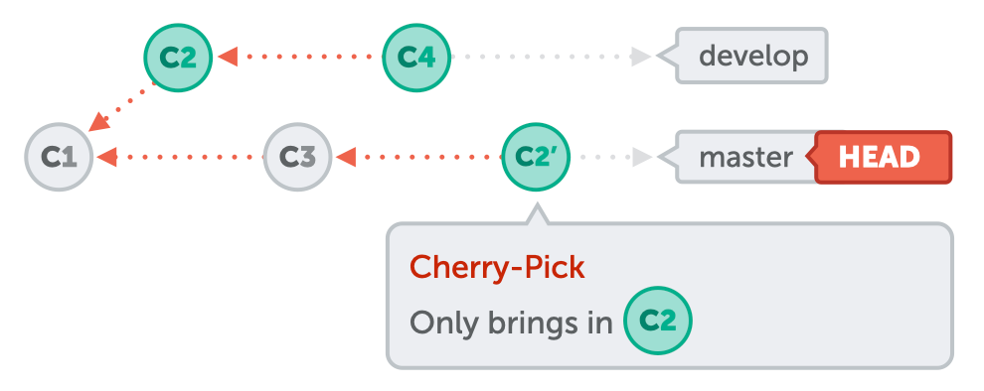
When and How?
git cherry-pick is a useful tool but not always a best practice. Cherry picking can cause duplicate commits and many scenarios where cherry picking would work, traditional merges are preferred instead. With that said git cherry-pick is a handy tool for a few scenarios.
Often times a team will find individual members working in or around the same code. Maybe a new product feature has a backend and frontend component. There may be some shared code between to two product sectors. Maybe the backend developer creates a data structure that the frontend will also need to utilize. The frontend developer could use git cherry-pick to pick the commit in which this hypothetical data structure was created. This pick would enable the frontend developer to continue progress on their side of the project.

Slide 14

Examples of git cherry pick
Syntax
git cherry-pick [--edit] [-n] [-m parent-number] [-s] [-x] [--ff]
[-S[<keyid>]] <commit>…​
git cherry-pick (--continue | --skip | --abort | --quit)
EXAMPLE
Passing the -edit option will cause git to prompt for a commit message before applying the cherry-pick operation
git cherry-pick master
Apply the change introduced by the commit at the tip of the master branch and create a new commit with this change.
git cherry-pick ..master
git cherry-pick ^HEAD master
Apply the changes introduced by all commits that are ancestors of master but not of HEAD to produce new commits.

Slide 15
IMPLEMENTATION OF GIT COMMANDS

Slide 16
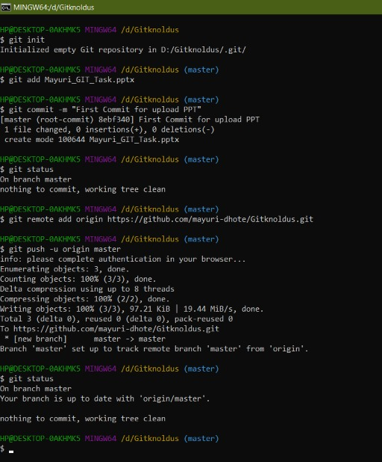
Steps for GIT:
First We initiated the git repository into the local folder
Adds files in the to the staging area for Git. Before a file is available to commit to a repository, the file needs to be added to the Git index (staging area).
We check current state of the repository
We commit the Files with Unique ID | Commit Message
We add Remote Repository path into it and connect with Remote Repository
At last we push data to Remote Repository

Slide 17
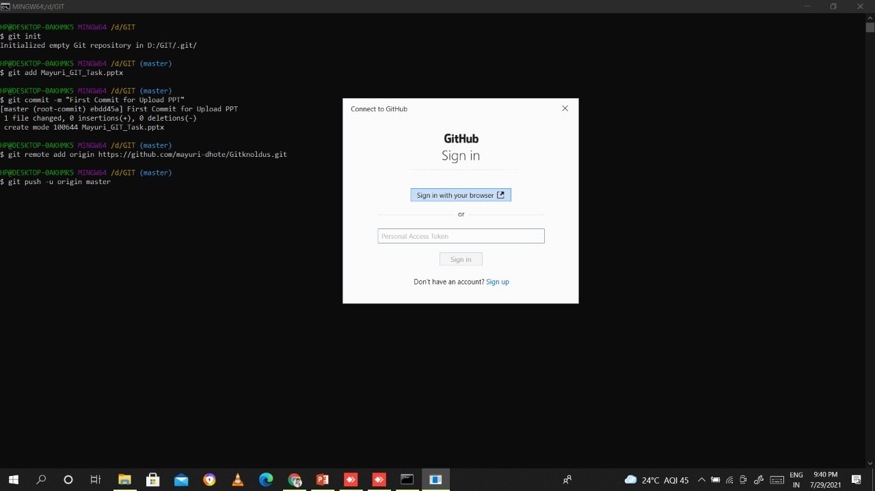
Command Used:
Git version
Git init
Git add .
Git status
Git commit –m “first commit”
Git remote add
https://github.com/mayuri-dhote/GItknoldus.git
Git push –u origin main
Git log

Slide 18
Getting Authorization from GitHub

Slide 19
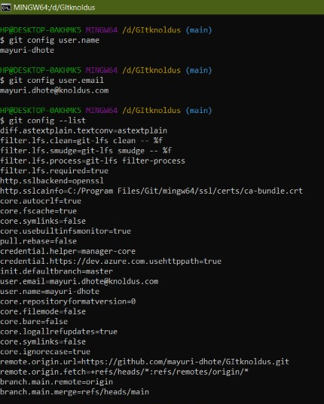
GIT CONFIG CONTROL
To see username and email which is used for commit
Git config –global user.name
Git config –global user.email
2. To update the user name and email we use:
Git config –global user.name “out username”
Git config –global user.email “our email address”

Slide 20
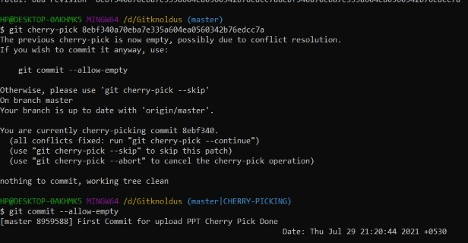
Cherry Command Execution
Git cherry-pick
060dfe88707188de1f362f62607689ea7025e263
2. Git commit –allow-empty

Slide 21
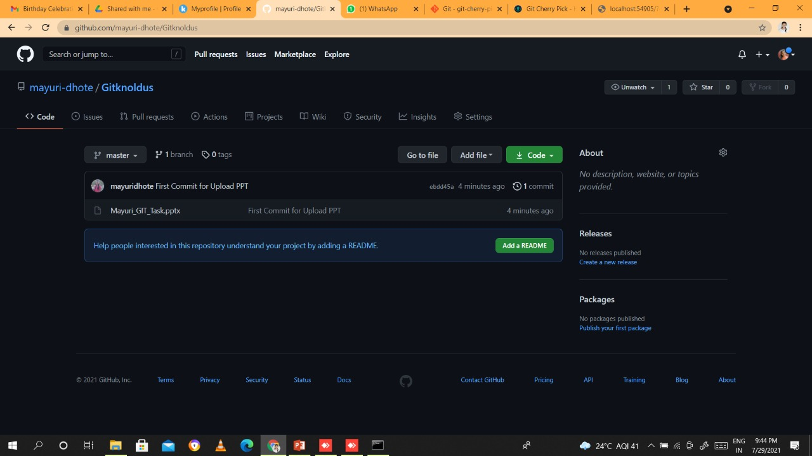
GITHUB Repository

Slide 22


GITHUB PROFILE
https://github.com/mayuri-dhote/GItknoldus

Slide 23
THANK YOU

